Slide 1
File I/O operations in Java
School of computer engineering and technology

Slide 2
Module 2B – File Handling in Java
The Concept of Streams
Types of Streams
Java programs to deal with files

Slide 3
Streams
What is a Stream?
Why deal with a file as a stream?
Stream vs Collection
Types of Streams
Byte stream
Character stream

Slide 4
File class in Java
import java.io.*;
Constructor of File class –
File(“path/to/the/file”);
Specifying a file to deal with –
File myFile = new File(“path/to/the/file”);
This guarantees neither existence, nor successful creation/opening of the file.
What if such a file does not exist?
NOT THE NAME OF YOUR FILE

Slide 5
Existence of File
An object of File class only gives a reference to the specified filename, irrespective of its existence.
Let’s have a look at this piece of code –
File aFile = new File("Sample.txt");
if(aFile.exists() == false)
aFile.createNewFile();
Built-in methods of the File class

Slide 6
Facilities for I/O with files in Java
Character Stream
Reader
FileReader
BufferedReader
Writer
FileWriter
BufferedWriter
Why use Buffered I/O?
….
….

Slide 7
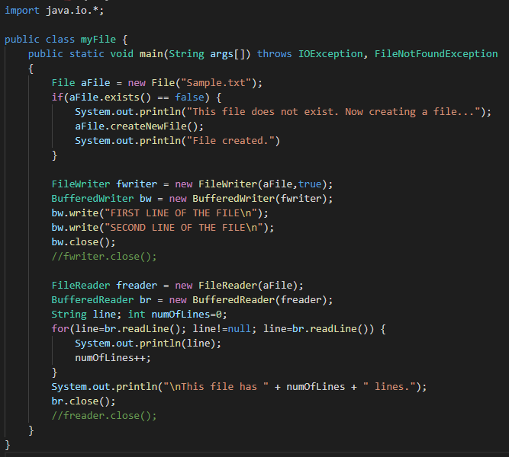
Writing a program
append
Do we need this?

